Slide 1
Logic Design Digital Watch
Prepared for
Dr. Hala Zayed
Benha University
Logic Design
Fall 2021

Slide 2
TABLE OF CONTENTS
1.
2.
3.
4.
Introduction
Procedure
Circuit Structure
Conclusion

Slide 3
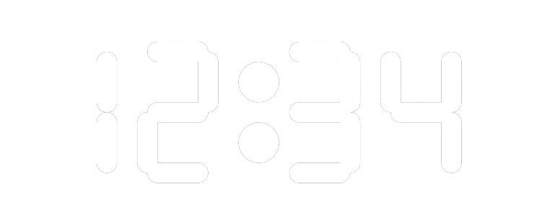
Introduction
Counting and keeping track of numbers are a few of the fundamental aspects we need to do regularly. Previously, people used to follow some orthodox procedure to do the calculation. Over time, due to the advancement of modern science and technology, we came up with better and more efficient methods for doing so. Now, different automated processes to do counting have been developed. Right after the industrial revolution, mechanical counters had been integrated with machines. Thus, from the 20th century and onward, counters and timers have been implemented with electronics.
A common example of a counter application in timekeeping systems is shown in this figure implified logic circuit of a digtal clock that displays seconds, minutes and hours.

Slide 4
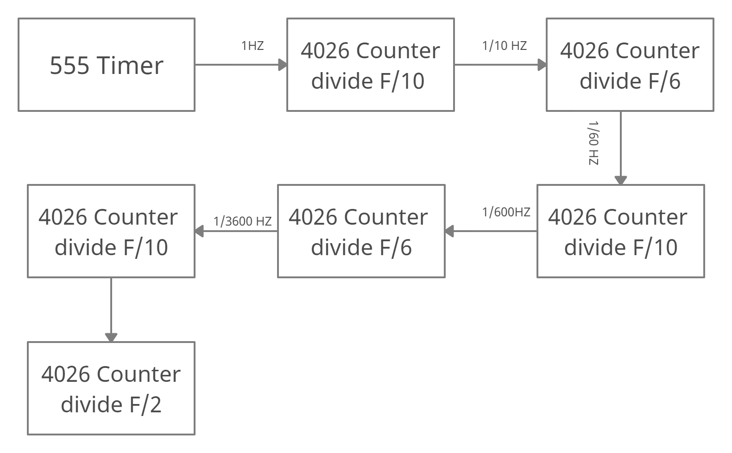
Procedure
A digital clock circuit is made of 4 blocks
The 4 blocks of a digital clock are:
A 555 timer 1 Hz clock generator that is used to generate 1 PPS (pulse per second) signal to the seconds block.
SECONDS block - contains a divide by 10 circuit followed by a divide by 6 circuit which Will generate a 1 PPM (pulse per minute) signal to the minutes block.
The BCD outputs connect to the seven segment circuits to display the seconds values.
MINUTES block - identical to the seconds block it contains 2 dividers; a divide by 10 followed by a divide by 6 which Will generate a 1 PPH (pulse per hour) signal to the HOURS block. The BCD outputs connects to the BCD to Seven Segment circuit to display the minutes values.
HOURS block - it is 24H clock, will have a divide 24. For 24H, it will count from 00 to 23. The BCD outputs connects to the BCD to Seven Segment circuit to display the hours values.

Slide 5
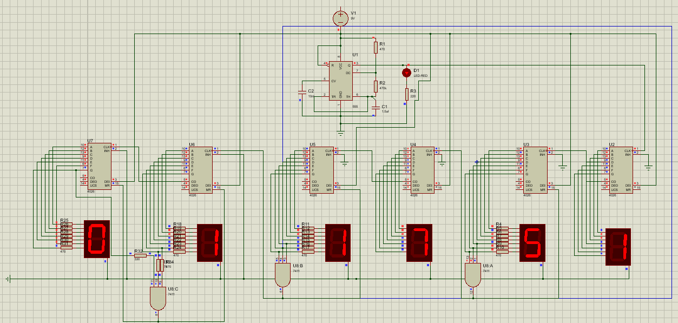
Circuit structure
Apparatus:
555 Timer
VCC 9 V
Resistors
Capacitors
4026 Decade Counter
7 Segment Common Cathode
3-Input AND Logic Gate

Slide 6
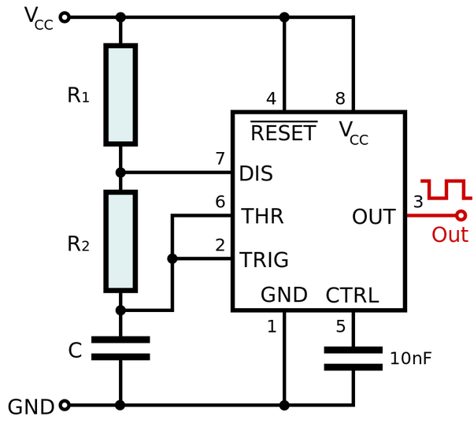
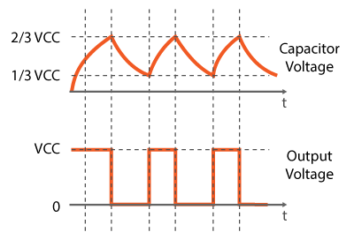

555 Timer
Astable timer is a device that has no stables the resulting output typically square wave that is used as a clock signal in many types of sequential logic circuits.
The frequency of the 555timer pulse could be controlled by selecting the right values for the Resistor R1,R2 and capacitor C1 using the following equation:
$$f=\frac{1}{T}=\frac{1.44}{\left(R1+2R2\right)∗C1}$$
After Calculations it was determined that the right values to result in a 1 HZ waveform is to make
R1 = 470Ω
R2 = 470KΩ
C1 = 1.5uf

Slide 7
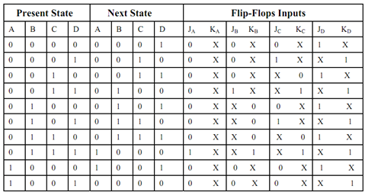
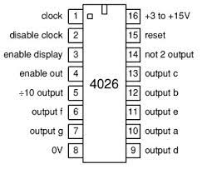
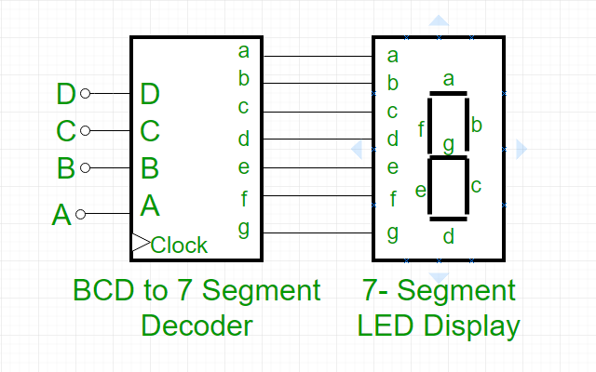
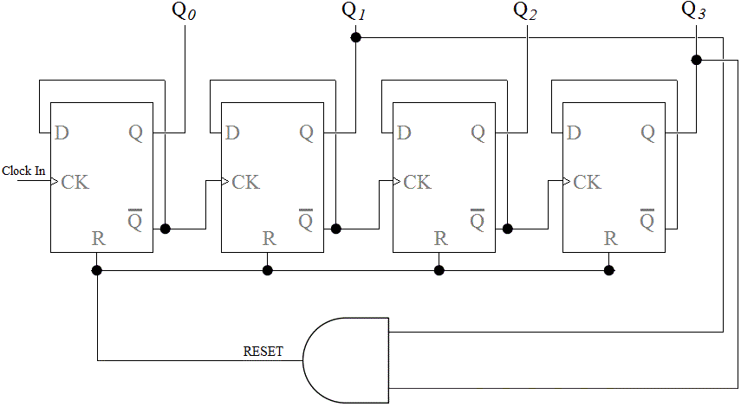
4026 Counter
4026 counter is an integerated circuit that is made of a 4 bit decade counter that counts from 0 to 9 and recycles at 9 going into a decoder that decode the BCD output to a 7 segment
Bin 1 is the input for the clock.
Bin 2 is connected to the ground.
Bin 3 connected to VCC.
Bin 5 is the output or the clock of the next counter and it is divided by 10 (number of counts).
Bin 15 is for reset.
Bin 6,7,9,10,11,12, and 13 are for the output.

Slide 8
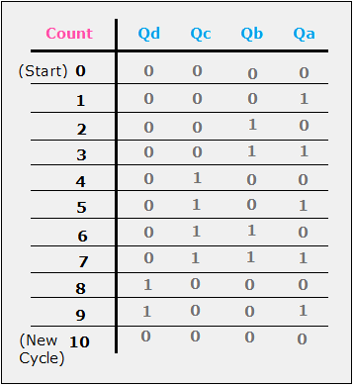
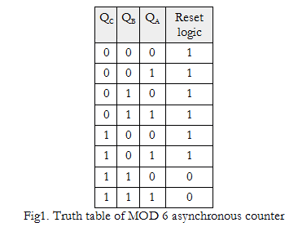
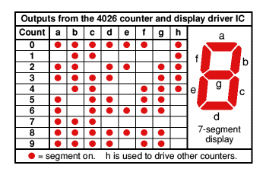
Counter of seconds
Counter of seconds is divided into two 4026 counters a single counter and a tens counter.
The single counter works on the 555 timer directly so it increment by 1 with every pulse that comes out of the 555 timer so it counts from 0 to 9 and then recycles.
The tens counter clock input is connected to the 5 pin of the previous counter so the tens counter is incremented by 1 every full cycle the single counter does.
The tens counter needs to stop at 6 and recycles, we can notice from the figureis that the first time the e, f, and g output are all on at the same time is when the output is 6.
e, f, and g outputs are connected to a 3-Input AND gate whose output is connected to reset the tens counter and to the clock of the next counter so the minutes is incremented by 1
Both of the counter are connected to a 7 Segment common cathode to display its output.

Slide 9
Counter of minutes
Counter of minutes is the same as the counter of seconds divided into two 4026 counters a single counter and a tens counter.
The single counter works on the output of the And gate which sends a pulse every time the seconds counter reach 60 seconds.
The single counter counts from 0 to 9 then recycles and its output which is divided by 10 is sent as the clock of the tens counter.
The tens counter is incremented by 1 every time the single counter finishes a cycle and then recycles when it reaches 6 as the e, f, and g output is connected to a 3-input AND gate which is connected to the counter reset input and the clock of the next counter (hours counter).
Both of the counter are connected to a 7 Segment common cathode to display its output.

Slide 10
Counter of hours
Counter of hours is divided into two counter one calculate the single and one calculate the tens
The first counter counts from 0 to 9 normally and its clock is coming from the minutes AND gate so whenever the minutes reach 60 a pulse is sent to the single hours counter.
The tens hours counter takes its clock from the single counter which means that whenever the single counter finishes a cycle a pulse is sent to increment the tens counter by 1.
Both the single and the tens counters need to stop at 24 so both of the counter needs to reset at the same time when the single reach 4 and the tens reach 2.
If we look at the figure we will see that the outputs f, and g are both on for the first time together at 4, and g is on for the first time at 2.
So if we connect the f, and g outputs from the single counter with the g output from the tens counter in a 3-input AND gate and connected its output to the reset input of both of the counter the clock would reset at 24
Count | Q0 | Q1
0 | 0 | 0
1 | 0 | 1
2 | 1 | 0
3 (recycles) | 0 | 0

Slide 11
Conclusion
The importance and application of these precision instruments are enormous in every work-field and our daily life and the logic sequential circuits comes really handy in making tasks much easier for everyone.
The output that is displayed on the digital screen makes it very much easy to make a variety of entries.
these devices are very economical, easy to operate and can be used for various purposes.

Slide 12
THANK YOU
Prepared by
Ibrahim Hani Mohamed Askar
Ahmed Gamal Abd ElKhaleq Gab Allah
Mohamed Abd ElAziz AbdElAziz Eisa

